Slide 1
Premier League Player Stat Predictions
Estimating Passes Per Game in Premier League Players
Rina Addiego
May 2021, STA-9890

Slide 2
Premier League Player Stats
Total: 571 Players, 59 Features
Exclusions:
Descriptive features like jersey number, country of origin, name.
Goalkeepers & related features
Final Dataset: N = 502, P = 46, numeric
Predictor: Passes/Played Game
Features Sample:
Interceptions
Wins
Penalties.scored
Passes
Big.chances.created
Fouls
Goals.with.right.foot
Appearances
Aerial.battles.lost
Shots.on.target
Notes:
Excluded Name, Jersey num, origin,
Also Goalies
Excluded goalies because their passes/game would be skewed since they have a vastly different role in the game
Wanted to pick something that wasn’t a total, that could be very obviously predicted by “games played” or a players career length/age (i.e. an older player would have more games)

Slide 3
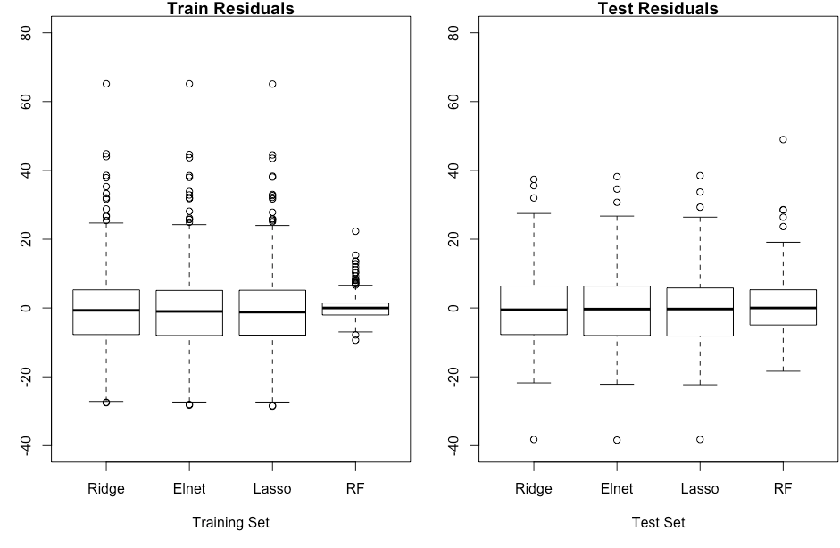

Slide 4
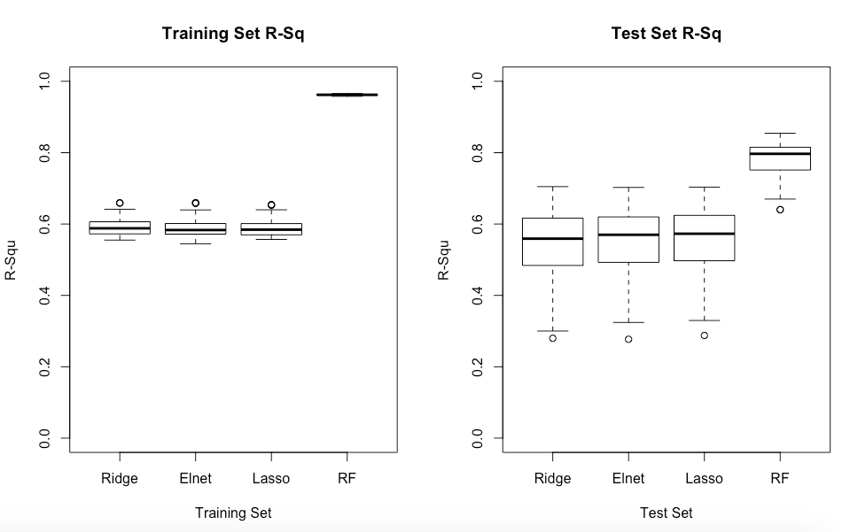
Notes:
Note: R-Squ represents how much of the variance in the dataset the model accounts for
R-squared is a statistical measure of how close the data are to the fitted regression line. It is also known as the coefficient of determination, or the coefficient of multiple determination for multiple regression.
The definition of R-squared is fairly straight-forward; it is the percentage of the response variable variation that is explained by a linear model. Or:
R-squared = Explained variation / Total variation
0% indicates that the model explains none of the variability of the response data around its mean.
100% indicates that the model explains all the variability of the response data around its mean.
Very low Rsq range on the training set, with a much larger range on the test set.
Models perform better on training set as predicted
RF model, when applied to training set, fits extremely well, very consistently – would have guessed it’s overfitting here
Ridge, Elnet, Lasso perform almost the same , with slight advantage to Lasso based on higher mean and marginally higher lower quartile bound
RF also outperforms on the test set, and also has a smaller range of R-quared values

Slide 5
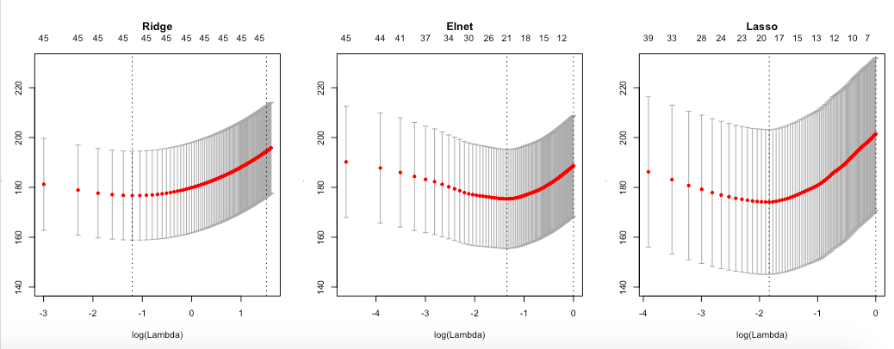
MSE
Log(Lambda)
Log(Lambda)
Log(Lambda)
Model | Ridge | El-Net | Lasso
CV Time | 0.1677s | 0.211s | 0.173s
Notes:
Cross validation curves capture the “U” shape
We can see Lenet & Lasso are roughly in agreement of how many variables to keep, lasso keeping slightly fewer
Cross validation times are similar, El-Net being slightly more than Ridge or Lasso

Slide 6
Model Fit vs. Time Cost
Model | R-Squ Interval (test set) | Time
Ridge | (0.496, 0.531) | 0.173s
El-Net | (0.496, 0.532) | 0.216s
Lasso | (0.508, 0.542) | 0.181s
RF | (0.767, 0.781) | 1.97s
Random Forest model outperforms Lasso, which slightly improves on El-Net & Ridge models
Runtimes for Ridge, El-Net, and Lasso models are similar
Random Forest has significantly longer runtime than the other three models
Notes:
~40% increase in performance between lasso -> RF
~900% increase in time cost

Slide 7
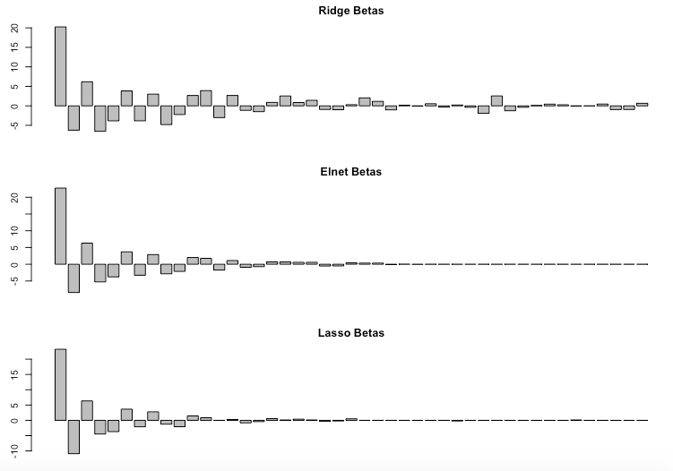
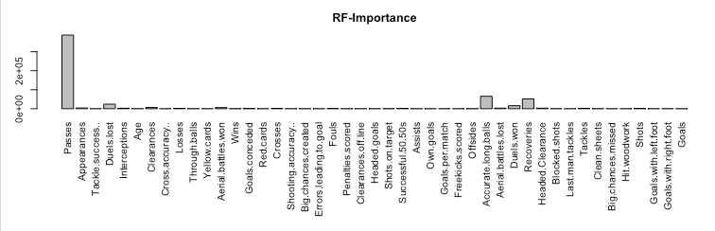
Ridge, El-Net, Lasso
Passes
Appearances
Tackle.Successes
Random Forest
Passes
Accurate.long.balls
Recoveries
Notes:
%IncMSE – need to look this up
Betas are similar for Ridge, Elnet, Lasso, as expected. Ridge
Three models models are in agreement on what the top three most important predictors are
Random forest is out of alignment with them
Of the top 3 predictors chosen, looks like they’re spread across functions offensive and defensive functions,

Slide 8
Conclusion
Random Forest model fits testing data best, with a ~40% increase in R-squ, but at a significant time cost
On this small dataset, time cost is not as significant
Important Predictors:
Three of four models are most dependent on “Passes” and “Appearances”
RF finds other more predictors important, to predict passes/game, but RF model finds ”Accurate Long Balls” and “Passes” more important

